Slide 1
CSYE6200: Concepts Of Object-Oriented Programming​
Project: Preschool DayCare​
Team 7 - Members
Names​​ | NUID​​
Jayanth Vakkalagadda​​ | 002950342​​
Rutvik Manishkumar Patel​​ | 002108900​​
Sai Meghana Surapaneni​​ | 002929424​​
Himanshu Walia​​ | 002960393​​
Ridham Mangukia​​ | 002104722​​
Vamsi Krishna Poluru​​ | 002924538​​
Ajay Kumar Reddy Nelavetla​​ | 002924033​​

Slide 2
Overview
Problem Statement and Requirements
Flow Of the Model
Technologies Used
Implementation and Methodology
DayCare Ratio Rules
Project Output
Learning Outcomes
Future Enhancements
Individual Contributions

Slide 3
Problem Statement and Requirements
The main implementation is to develop the DayCare Model using the different Object-oriented principles and patterns with the following requirements:
Enrolling the Students and capturing the data.
Grouping the Students and Teachers to different classrooms on various ratio rules.
Tracking the Student Registration.
Tracking the Students Immunization records.
Alerting the overdue dates of Immunization of Students.
Tracking the annual employee review.
Tracking all entities through CSV files.
Using database for data entry.
Implementing the model with the GUI using different entities.
Implementation of Design patterns like Factory Design pattern and MVC pattern.

Slide 4
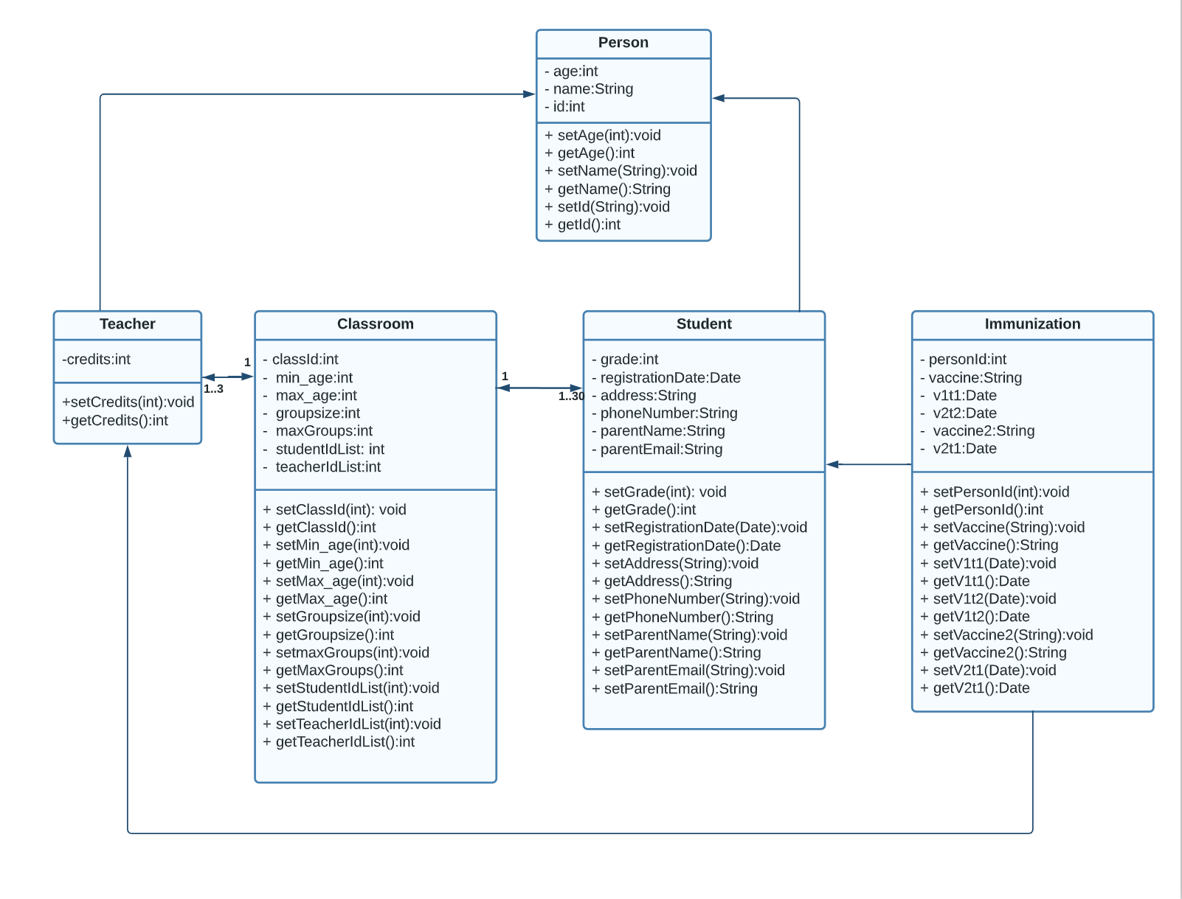
Flow Of The Model
The model flow mainly depends on Person, Classroom, Student, Teacher, Immunization classes.

Slide 5



Technologies Used
Programming language used: Java.
Tools Used: Eclipse IDE, NetBeans.
Front-end Technology: Java Swing.
Back-end Technology: Java Spring Boot.
Data Base: H2 Embedded Database.
Design Patterns Used: Model View Controller Design Pattern, Factory Design Pattern, Streams
Build Tool: Maven

Slide 6
Implementation and Methodology
The projects flow is mainly concentrated on developing using MVC and Factory Design Pattern.
In Model, the dependencies and fields are created through Person, Classroom, Student, Teacher, Immunization classes .
In View, the main GUI components are built using Java Swing.
The Controller represents the classroom grouping with Immunization records of students recording and retrieving the timelines of Vaccinations through StudentController, TeacherController, ImmunizationController. This acts as an interface between the model and view components.
The GUI part shows the DayCare Website where Student registration, Immunization records tracking and Teacher records with classroom grouping on different ratio rules of the data.
Through CSV files the data is inputted to H2 Database Engine which retrieves the Student’s and Teacher’s data Immunization records of students, and the timelines are recorded and depending on the different timelines of vaccination due alerts are created.
The detailed website is created for all the Daycare activity tracking using JavaSwing with Spring Boot has back-end element and different threading elements are also implemented.
Objects from CSV:
Student: Student Enrollment Roster
Teacher: Employee Roll
DayCare Ratio Rules: Student to Teacher::Groups to Classroom

Slide 7
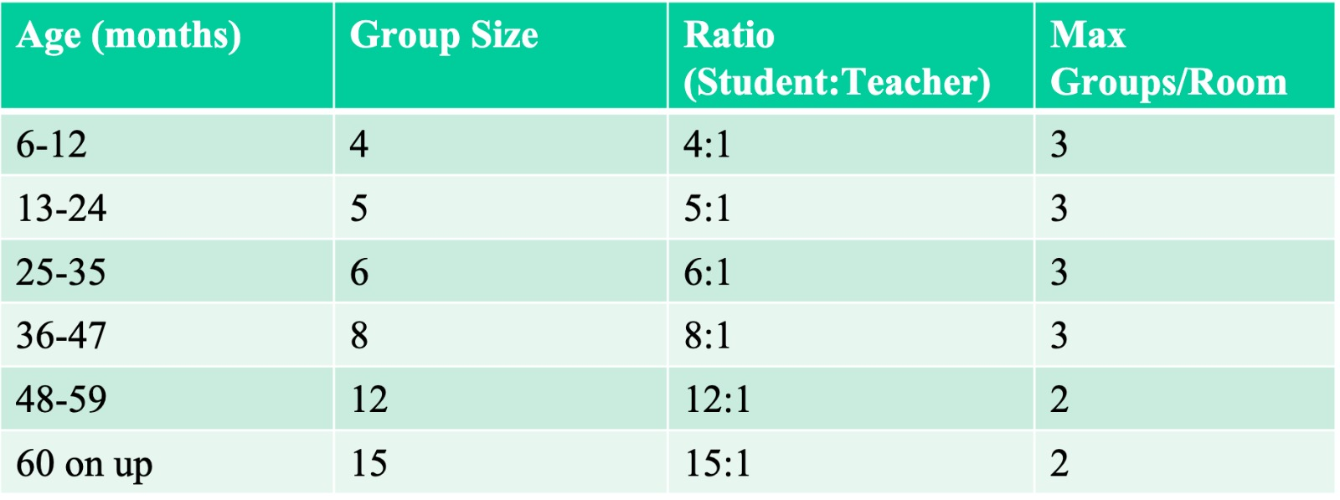
DayCare Ratio Rules

Slide 8

Project Output
1. Login Page:

Slide 9
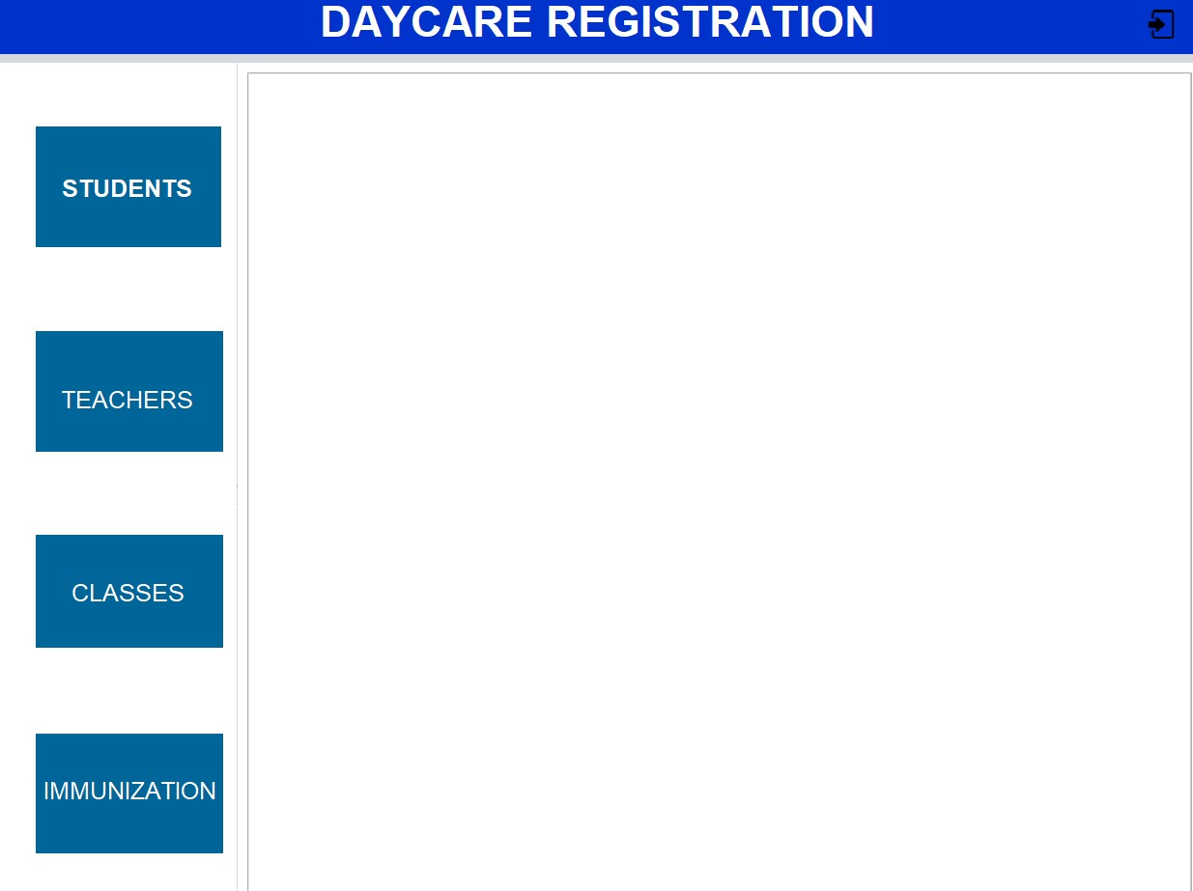
2. Menu Page:

Slide 10
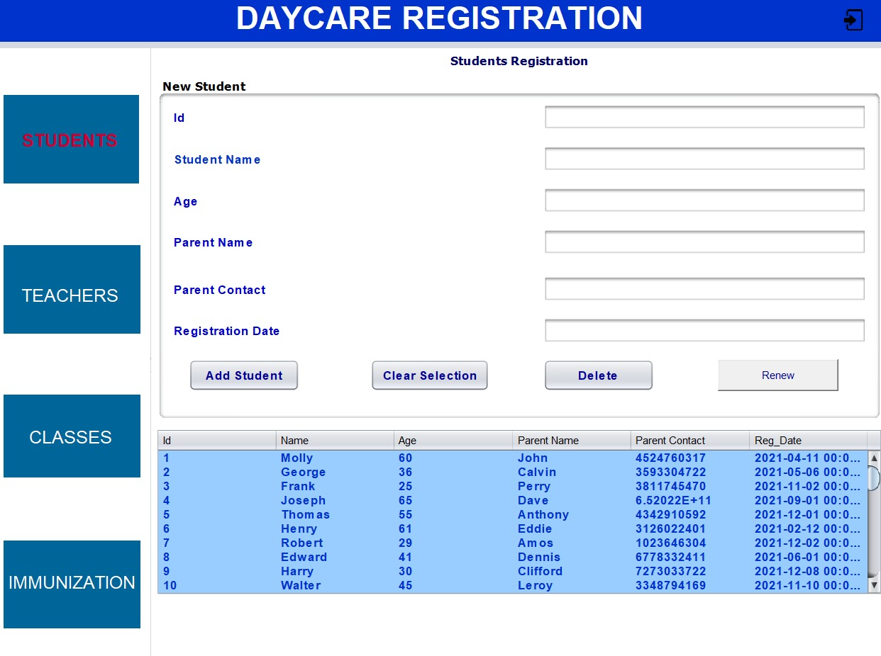
3. Student’s Page:

Slide 11
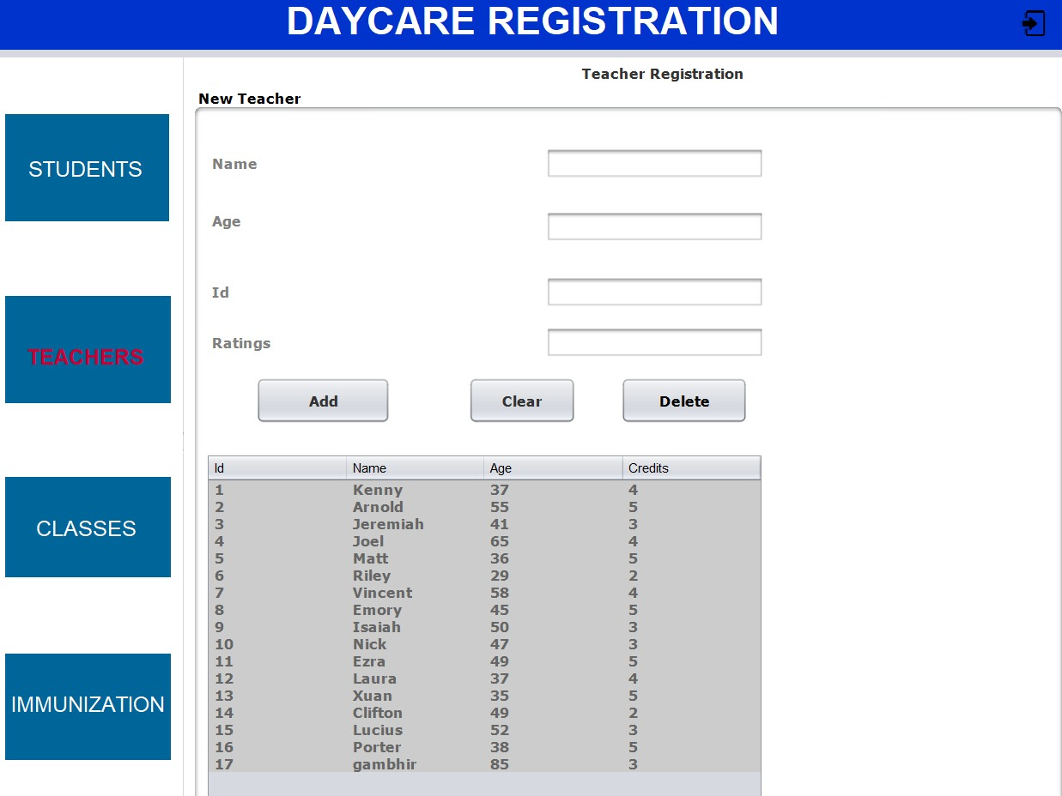
4. Teacher's Page:

Slide 12
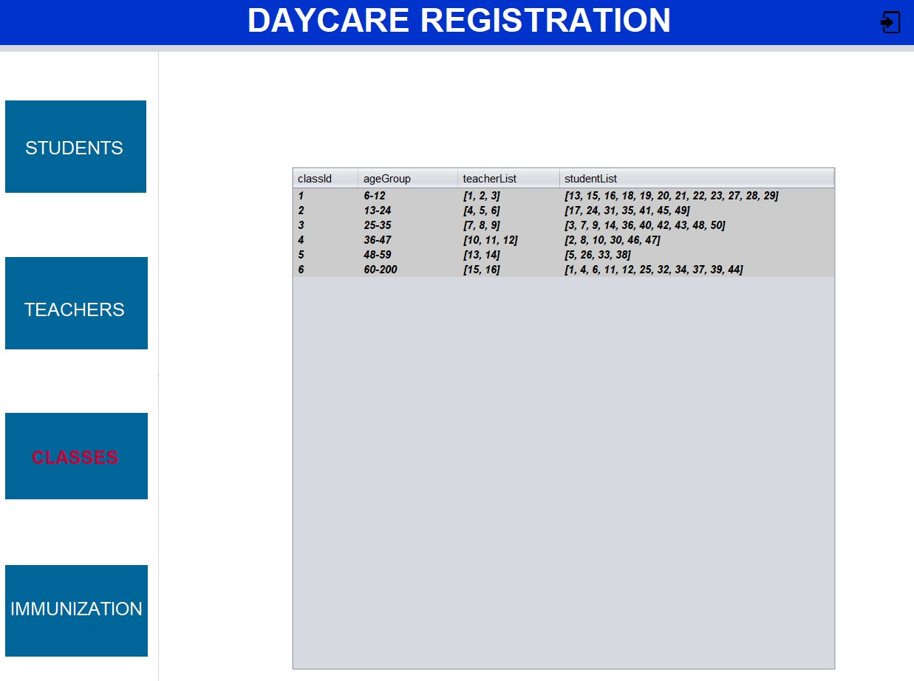
5. Classroom Page:

Slide 13
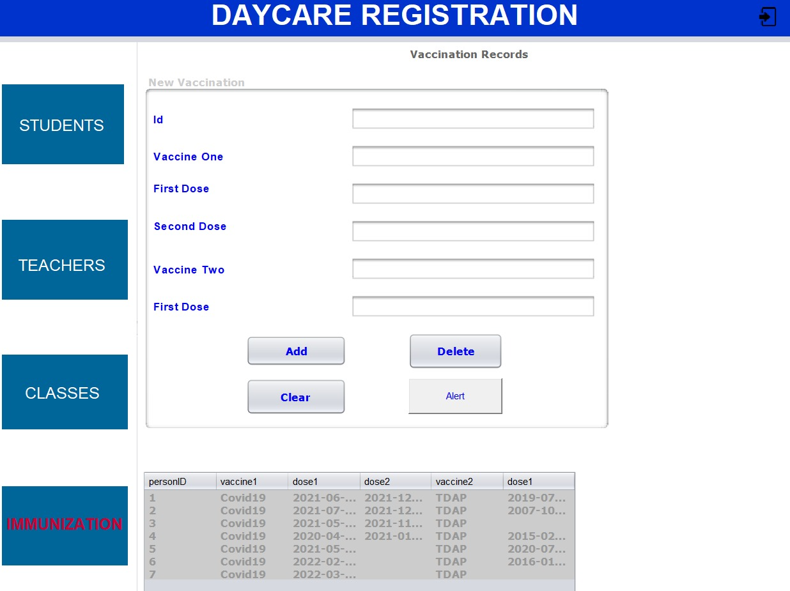
6. Immunization Page:

Slide 14
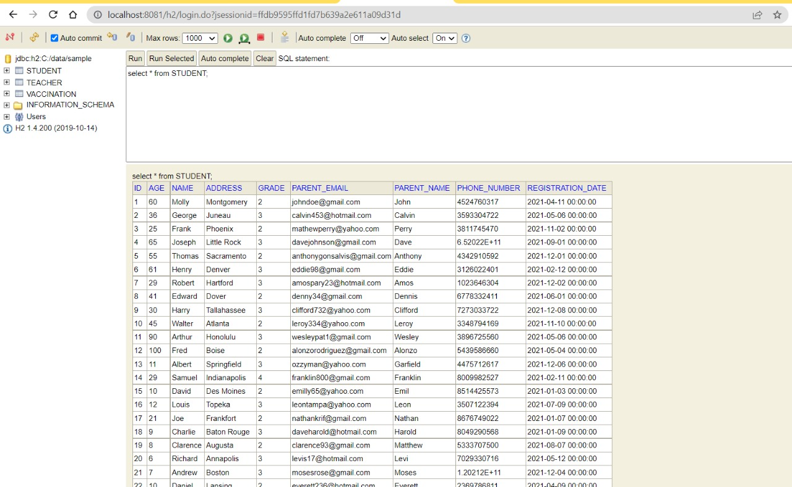
Database Records:

Slide 15
Learning Outcomes
In this project the main learning outcomes are as follows:
Able to learn different Design patterns mainly MVC and Factory Design Patterns along with different object-oriented principles.
Representation and usage of Java Swing for GUI of DayCare model.
Implemented Database CRUD operations.
Understanding of Spring boot functionality and backend implementation.
The clear understanding of different dependencies used in the project.

Slide 16
Future Enhancements
The interface can be more interactive and engaging with new technologies like React Native etc..
Can be developed interactive statistical analysis on the clinical data using Teacher and Students.
Deployment can be made using any Cloud hosting platform with enhanced encryption .
Adding the Realtime notifications.
Adding the Healthcare Physician for better suggestions regarding the Immunizations.

Slide 17
Individual Contributions
Name | Contribution
Jayanth Vakkalagadda | Frontend: Swing UI - classes pane, BE integration
Rutvik Manishkumar Patel​​ | Backend and Testing: BE logic for persons, Testing(UI,BE) and Reporting
Sai Meghana Surapaneni​​ | Backend: Immunization Backend, FactoryPatterns for Object Creation
Himanshu Walia​​ | Frontend and Backend: Teacher JTable, SpringBoot, DB integration, BUG fixes
Ridham Mangukia​​ | Frontend, Database and Backend: Student JTable, Classroom, Backend, spring integration
Vamsi Krishna Poluru​​ | Integration and Backend: Swing UI - vaccinations, BE integration, alert notifications
Ajay Kumar Reddy Nelavetla​​ | Backend: Immunization Backend, FactoryPatterns for Object Creation

Slide 18
!!!!!Thank You!!!!!

